Slide 1
Emotional and Cognitive Decision-Making Modeled using EEG Imaging
Thomas F. Collura, Ph.D., MSMHC, QEEG-D, BCN, LPC
Midwest Society for Behavioral Medicine and biofeedback
November 1, 2014

Slide 2
Description
This workshop will present current results using an EEG-based activation model that takes advantage of sLORETA imaging of frontal regions of interest, in combination with a structured stimulus and analysis procedure. We will present event-related brain activation data from a range of participants and situations including nonclinical, clinical, and forensic populations. The results illustrate instantaneous patterns of frontal activation that are indicative of individual emotional and decision-making patterns.

Slide 3
Objectives
Recognize EEG patterns associated with specific emotional responses and states.
Explain how the frontal cortex participates in the creation of emotional responses to stimuli.
Describe the brain locations involved in positive and negative emotional responses in normal processes.
Describe aberrations in normal brain processing, that can lead to abnormal emotional responses or states.
Explain how different interventions have differing effects on the dynamic control of emotion.

Slide 4
Background
Frontal asymmetry associated with mood
Davidson, Rosenfeld, Baehr
Left = “positive”
Right = “negative”
Past work used alpha asymmetry
New work is using gamma
Not trait only – now looking at state responses to stimuli
Incorporation of decision-making model

Slide 5
New Methods
Use of Gamma (activation) rather than Alpha (relaxation)
Use of sLORETA (brodmann, ROI) rather than surface
Note that many frontal dipoles are lateral (parallel to surface)
Use of event-related paradigms
Separation of state and trait characteristics
Development of emotional and ethical decision-making methods

Slide 7
Event-Related EEG Imaging

Slide 8
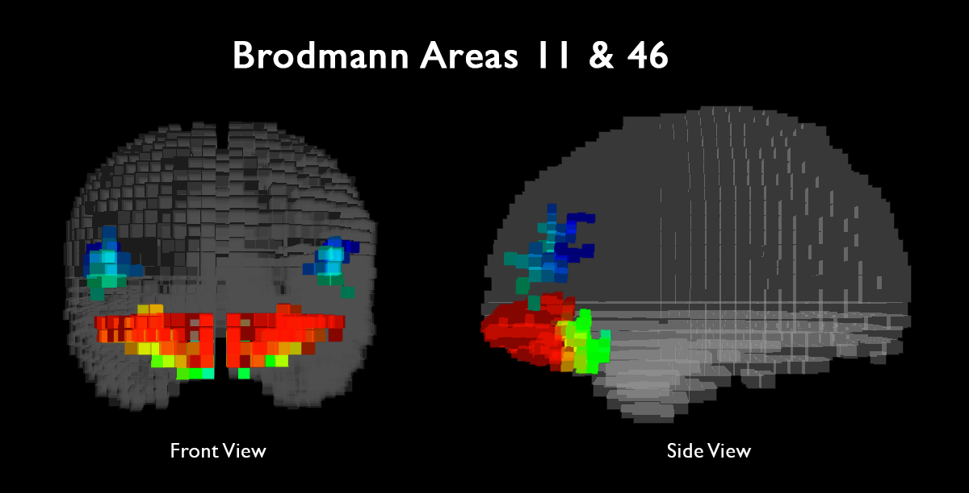
Key emotional regulatory centers primary and secondary emotional response Emotional sensation -> emotional perception

Slide 9
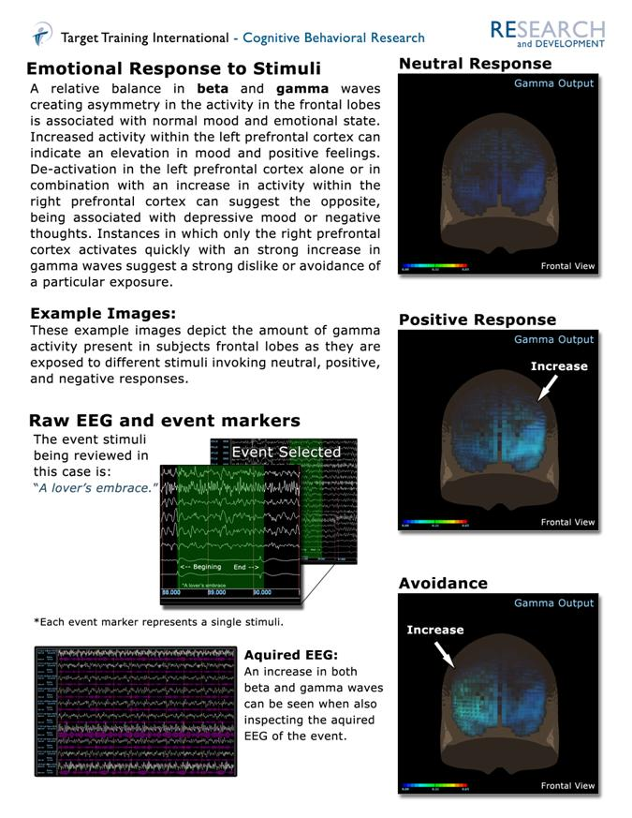

Slide 10
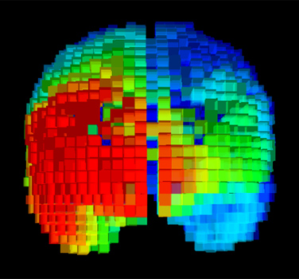
Baseline Mood State Depressed

Slide 11
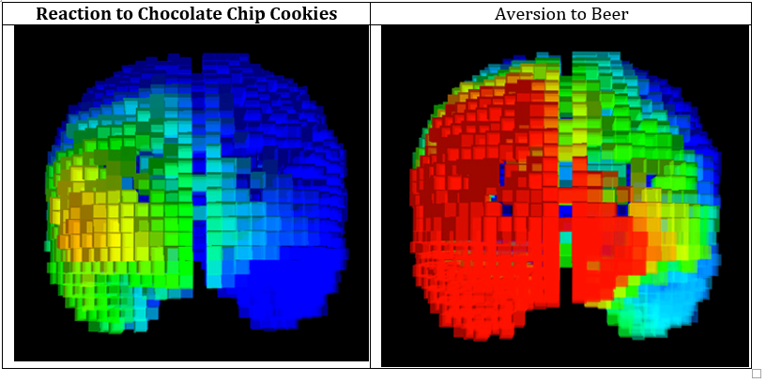

Slide 14
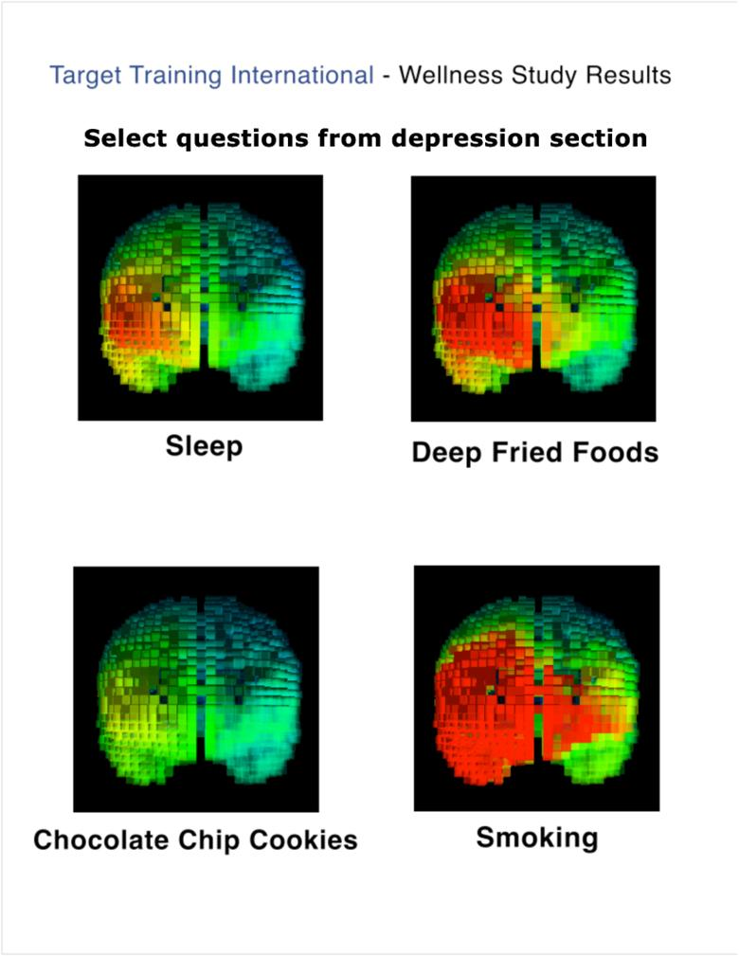

Slide 15
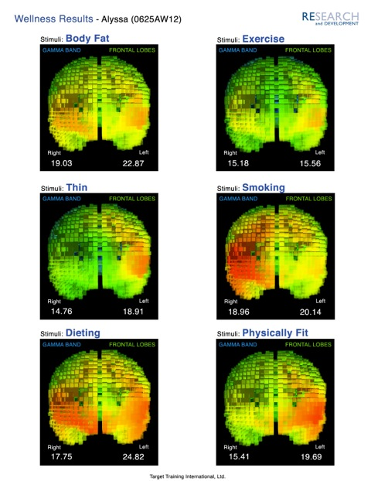

Slide 16
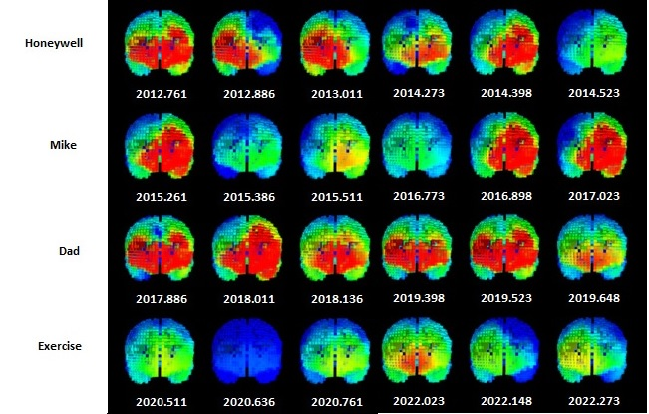

Slide 17
Left-Right Functionality
Mechanism | Parallel | Serial
Hemisphere | Right | Left
Data Representation | Holographic | Sequential
Perspective | Visuo-spatial | Temporo-linguistic
Analogous to | Pictures | Music, speech
Context | Global (this always…) | Local (in this particular case,…)
Orientation | Patterns | Lists
Tasking | Multitasking (may be stressful) | Single-tasking (focused, calm)
Perspective | Past | Future
Dimension | Space | Time
Attribute | Patterns (spatial) | Causality
Memory | Past patterns, “punishment” | Cause/effect experiences, rules
Mode of analysis | “the last time…” | “what if…”
Result | Avoid / Attack | Approach / Remain

Slide 18
Left-Right Mood Regulation
Emotion | Negative | Positive
Decision cycle | 1 analysis | Sequence of n analyses
Activation sequence | 1 “found” | N “not founds” then done
Priority | Detecting danger | Ensuring safety
Decision priority | Immediate | Long-term
Approach | Tactical, here & now | Strategic, future outcomes
Equation parameters | Pp+=1, Ppf=1 | Ps+=1, Psf=1
Associated behaviors | Run; fight | Breathe; build
Neurotransmitter | Adrenalin | Serotonin

Slide 19
Mesial – Dorsolateral distinction
Mesial – primary emotional sensation
Fundamental, initial sense –”nice” or “not nice”
Dorsolateral – seconday emotional perception
Integrated with memory
Put into context
Can turn interpretation “around”

Slide 20
Emotional Decision Making Model (why we downtrain alpha on the left dorsolateral frontal lobe)

Slide 21
Happiness as a process

Slide 22
Depressed

Slide 23
Paranoid

Slide 24
Risktaker

Slide 25
Chronic Anxiety

Slide 26
General Anxiety

Slide 27
Quantitative Model

Slide 28
Use of characteristic qualitative/quantitative types

Slide 29
Forensic Emotional Imaging

Slide 30
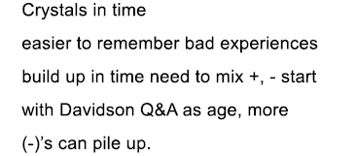
Emotional Transition Model

Slide 34
Insights
It takes more work to be positive than to be negative
Specific emotional/cognitive skills necessary for healthy mood
Balance of negativity an positivity is essential for effective functioning
Specific deviations associated with particular emotional/behavioral styles
Response to stimuli as important (more important) than resting state
Model for client-clinician interaction, other interactions

Slide 35
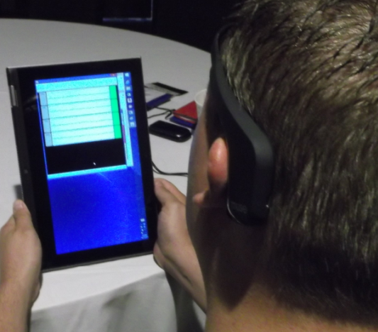
New Hardware / Software

Slide 36
Emotional Decision-Making App

Slide 37
Summary
Dynamical model of mood regulation and emotional decision-making
Multicomponent model, distributed functions
Identification of specific excesses/deficits
Activation / deactivation
Connectivity / isolation
Correlation with EEG parameters, power, connectivity
Methods for assessment, treatment, treatment effectiveness
Recognition of trait and state individuality

